Slide 1
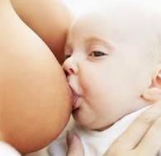
LACTATION AND LACTATIONAL COMPLAINTS
DR. L. GIRIJA., READER,
DEPARTMENT OF GYNAECOLOGY AND OBSTETRICS,
UNIT HEAD MOTHER &CHILD CLINIC
SARADA KRISHNA HOMOEOPATHIC MEDICAL COLLEGE,
KULASEKHARAM, KANYAKUARY DST, TAMILNADU

Slide 2

Physiology of lactation
Mamogenesis (Mammary duct-gland growth & dev.)
Lactogenesis (Initiation Of milk secretion in alveoli)
Galactopoiesis (Maintenance of Lactation)
Galactokinesis (Removal of Milk from Gland)

Slide 3
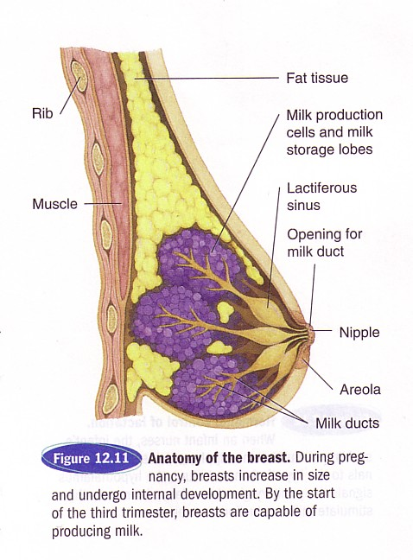

Slide 4
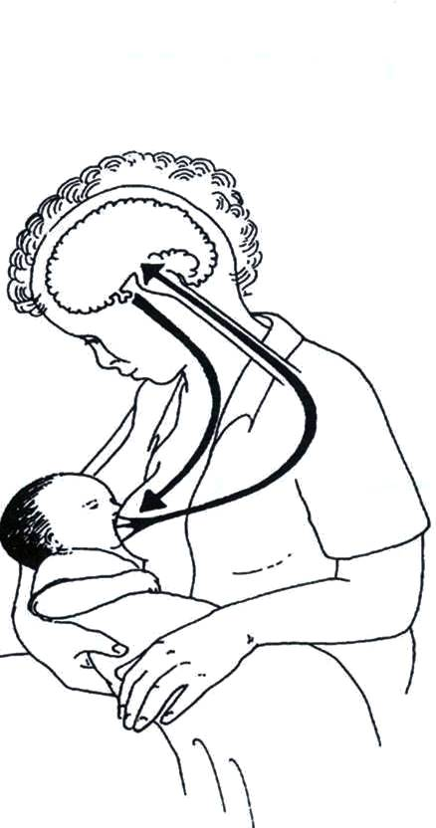
Prolactin “milk secretion” reflex
Enhancing factors
Hindering factors
Early initiation
of breastfeeds
Delay in initiation
of breastfeeds,
Pre-lacteal feeds,
Bottle feeding,
Incorrect positioning,
Painful breast
Good attachment
& effective suckling
Frequent feeds
including night
feeds
Emptying
of breast
Prolactin in blood
Sensory impulse from nipple

Slide 5
Oxytocin reflex
Stimulated by
Inhibited by
Thinks lovingly of baby
Sound of the baby
Sight of the baby
CONFIDENCE
Worry
Stress
Pain
Doubt

Slide 6
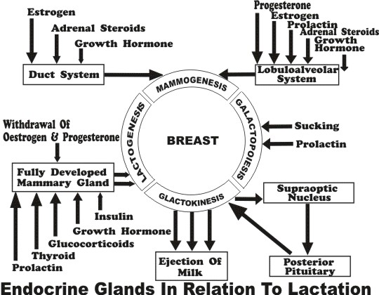

Slide 7
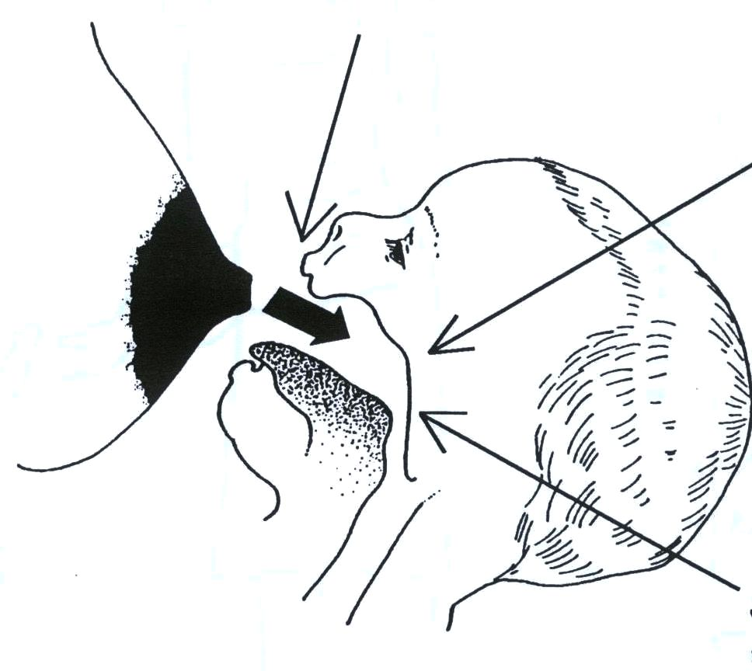
Feeding reflexes in the baby
Rooting reflex
Child to instinctively suck at anything that touches the roof of their mouth .
Sucking reflex
Swallowing reflex
Rooting reflex
A newborn infant will turn his head toward anything that strokes his cheek or mouth, searching for the object by moving his head in steadily decreasing arcs until the object is found. IT is present at birth; disappearing at around four months of age as it gradually comes under voluntary control.

Slide 8

Healthy mother secrets about 600 ml (up to 850 ml) milk per day during first 6 months
Nutrition expert committee prescribed additional calories 550 and 400 respectively for 0-6 months and 6-12 months
Practices to avoid
  Alcohol, drugs, smoking, excess caffeine

Slide 9
"No two mothers produce identical milk. The composition of mother’s milk varies from day to day and during different times of the day. The colostrum the baby receives on the first day of his life is different from the colostrum on day two or three."

Slide 10
Benefits of Breastfeeding
Benefits of Mothers
Breastfeeding helps in
Quick recovery after childbirth, with reduced risk of postpartum bleeding.
Early return to their pre-pregnancy weight.
Enhancing the feelings of attachment between the mother and infant
Preventing pregnancy.
Helps in involution of uterus
Decreases mother’s workload, saves time and energy
Lowers risk of breast and ovarian cancer
Breast Feeding reduces the risk of
Ovarian and pre-menopausal breast cancers.
Osteoporosis.
Long-term obesity.
Anemia by delaying the return of the menstrual cycle.

Slide 11
Benefits for Infant
Breastfeeding provides benefits for full-term as well as premature and low birth weight infants.
Breastfed children
Are healthier and have fewer symptoms and shorter illnesses when they get sick.
Score higher on cognitive and IQ tests at school age, and also on tests of visual acuity.
Have a lower incidence of sudden infant death syndrome (SIDS).
Are less likely to suffer from infectious illnesses and their symptoms (e.g., diarrhea, ear infections, respiratory tract infections, meningitis).
Have a lower risk of the two most common inflammatory bowel diseases (Crohn’s disease, ulcerative colitis).
Suffer less often from some forms of cancer (e.g., Hodgkin’s disease, childhood leukemia).
Have a lower risk of juvenile onset diabetes.
Are significantly protected against asthma and eczema.
May have a lower risk of obesity in childhood and in adolescence.

Slide 12


Slide 13
VARYING COMPOSITION OF BREAST MILK
Colostrum – secreted during first three days after delivery. It is yellow, thick containing more antibodies and cells and high amount of vitamin A, D, E and K
Transitional milk – milk secreted next two weeks. Proteins and immunoglobulin decrease and fat and sugar increase
Mature milk – follows transitional milk. Contains all essential nutrients for baby growth
Pre term milk – mother who delivers prematurely contains more protein, sodium, iron, immunoglobulin and calories, as they are needed to pre term babies.
Fore milk – milk secreted at the start of feed. It is watery, rich in protein, sugar, vitamins and minerals.
Hind milk – comes later towards end of feed. Provides fat and more calories.

Slide 14
COLOSTRUM
The Colostrum is one of the best things that a mother can give to the baby.
It is the watery - yellowish fluid that comes in first 3 days from the mammary glands.
It is rich in protein. It contains immunoglobulin's (IgG, IgA), which confers immunity to certain infections (Polio, measles, influenza etc) during first few months of life. So, Colostrum is considered as the first immunization to the infant.
Enzymes like lysozyme, peroxidase and xanthine oxidase that promote cell maturation are found in colostrum.
Colostrum is rich in leucocytes that fight against viruses and bacteria that cause disease.

Slide 15

BREAST MILK
 | Protiens | Fat | Carbohydrates | Water
Colostrum | 8.6% | 2.3% | 3.2% | 86%
B.Milk | 1.2% | 3.2% | 7.5% | 87%
Cow’s Milk | 3.4 | 3.5 | 4.5 | 88%
600 ml/day of human milk is enough to meet the nutritional requirement up to first 6 months
Beyond 6 months, the mother’s milk alone is not enough to meet the nutritional requirement

Slide 16

FEEDING POSITIONS
Feeding can be done in any position in which mother and baby are comfortable.
The child should be attached properly to the breast so as to insert whole nipple and most of areola in her/his mouth.
The head and body should be in one line and supported and child should be held close to breast.

Slide 17
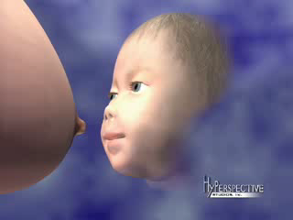

Slide 18
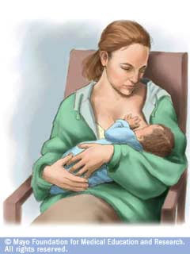




Cradle hold cross cradle hold Football hold
Side lying

Slide 19
Signs of good attachment | Signs of effective suckling
More of areola visible above the baby’s mouth Mouth wide open Lower lip turned outwards Baby’s chin touching breast | Slow, deep sucks, sometimes pausing

Slide 20

First feed | In the case of normal delivery and in absence of any medical complication In the case of cesarean section. | • Put baby to breast within ½ - 1 hour. Duration may be increased to 4-6 hours.
Frequency of feeding | During the first 24 hours • By the end of the first week | Feed the baby at the interval of 2-3 hour Establish regular pattern of feeding at the interval of 3-4 hour, not less than 8 feeds / day. Feed the baby more on demand.

Slide 21
Demand feeding • | Put the baby to the breast as soon as he/she becomes hungry. There is no restriction of the number of feeds and duration of suckling time.
Duration of feed • | Feed initially for 5-10 minutes at each breast (to condition let down reflex). • Thereafter, gradually increase the time spent. • Feed the baby completely from one breast so that baby gets both the foremilk and the hind milk (richer in fat and calories). • Put the baby to other breast if required. • Start the next feed from second breast.
Night feed • | In the initial period, give night feed to avoid long interval between feeds. (To avoid engorged breast and hardening of the breasts) • Later, usual 3-4 hourly feeding pattern is established.
Amount of feed • | Average requirement of milk : 100 ml. / kg / 24 hours on the third day and increases

Slide 22

Nipple confusion
Burping
Baby friendly hospital
Humanization of cows milk

Slide 23
Medicines contraindicated during lactation
Chemotherapeutic agents.
Drugs of abuse e.g. marijuana, heroin, PCP, nicotine, etc.
Radioactive compounds
Anti-anxiety, antidepressants, and antipsychotic medication's effects are not known but are of concern.

Slide 24

Conditions those are contraindicated for breast-feeding | Conditions that are not contraindicated for breast-feeding
In infant Infant with galactosemia. | Mother taking antiretroviral medications Mother with Hepatitis B surface antigen positive Mother with Hepatitis C infection Cytomegalovirus (CMV) infection in mothers
In Mothers Mother with active tuberculosis Mother infected with the HIV Mother is on medications that are contraindicated during lactation. | In all full term infants, the benefits of breastfeeding appear to outweigh the risk of transmission from cytomegalovirus.
•
.

Slide 25
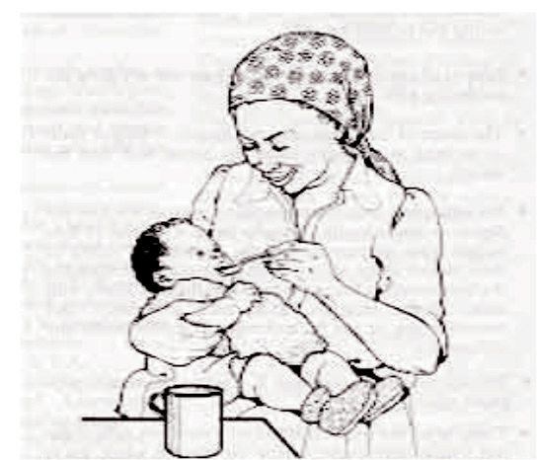
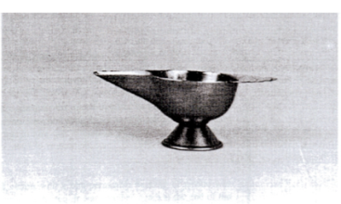

EXPRESSED BREAST MILK (EBM)
Indications
  Sick mother, local breast problems
  Preterm / sick baby
  Working mother
  Methods
  Manual expression
  Breast pump
Storage
  Clean wide-mouthed container with tight lid
  At room temperature: 6 hrs
  Refrigerator: 24 hours; Freezer (20°C): for 3 months
It is not advisable to boil the EBM.
Feed with cup or spoon or paladai, never feed with bottle.

Slide 27
Common complications of breast in puerperium
Breast engorgement
Cracked/flat nipples
Mastitis and Breast abscess
Failing lactation

Slide 28
BREAST ENGORGEMENT
Causes
Delay in starting breast feeding
Infrequent feedings
Restriction of length of feed; small feedings may cause incomplete emptying of the breast.
If the breast-feeding is suddenly stopped by mother or if the baby stops taking the feeds.
If the baby’s breast milk intake drops, due to weaning to solid foods or illness.
Incomplete emptying
of breast
Incomplete emptying
of breast
Difficulty to latch on
properly for the baby
Infrequent feeding
Breast engorgement
Infective mastitis
Non-infective mastitis
Milk stasis

Slide 29
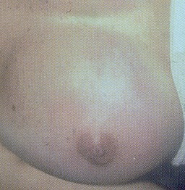
BREAST ENGORGEMENT
Onset
  On the 3rd or 4th day due to increased milk production
Symptoms:
  Pain, tenderness or heaviness in the breasts
  Mild fever
  Painful feeding
Prevention:
  Manual expression or with breast pump
Treatment :
  Support & promote the use of brassiere after delivery
  Ice bag application
  Baby to be fed regularly
  EBM if more left after feed

Slide 30
BREAST ENGORGEMENT
Homoeopathic management
Conium maculatum
Belladona
Calendula officinalis
Phellandrium aquaticum
Bryonia alba
Lac caninum
Phytolacca decandra

Slide 31
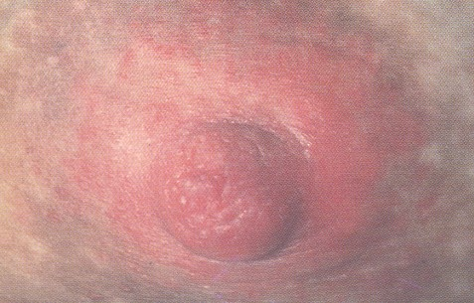
CRACKED AND SORE NIPPLES
Causes
Maternal
• Poor breast feeding technique:
• Unhygienic habits causing the crust formation over the nipples.
• Retracted nipples.
Infantile
Candida infection (Oral Thrush)

Slide 32
CRACKED/FLAT NIPPLES
Cracked nipples may become a painful condition due to a fissure on the surface.Condition is asymptomatic but becomes painful due tosucking
Prevention:
  Cleaning of the crust on the nipple after every feed
  Proper latching of the baby during every feed
Treatment:
  Mothers foremilk applied on the cracks helps in the healing
  Nipple shield – to prevent direct contact with the breast

Slide 33
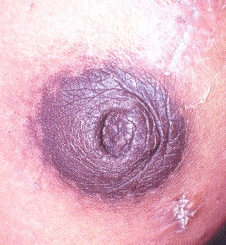
With the above measures cracks heal in 1-2 days but if not
Rest for 24 hrs from feeding
Bandaging of the wound with local antiseptic ointment
If the crack or fissure remains non healing, a surgical opinion should be taken to rule out malignancy
Flat nipple:
Manual lifting of the nipples from the Antenatal period

Slide 34
Mastitis and Breast abscess
Acute mastitis is the inflammation of the breast following infection
It is of two types
  Cellulitis (infection through cracked nipple)
  Primary adenitis (infection through lactiferous duct)
Encourage mother to continue breastfeeding.
Teach correct positioning and attachment.
Give appropriate homoeopathic treatment.
Reassess in 2 days.
If no improvement or worse, refer to hospital.
Express milk from the affected breast and discard until no fever
Improvement - Continue same measures
No improvement or secondary infection - Refer to Obstetrician for management

Slide 35

Mastitis
Homoepathic Management
Castor equi
Graphites
Phytolacca decandra
Ratanhia peruviana
Sarsaparilla officinalis
Calendula officinalis
Phellandrium aquaticum
Arnica
Borax
Calcarea carbonica
Chamomilla
Croton tiglium
Hamamelis
Helonias
Pulsatilla
Sepia
Silicea
Sulphur

Slide 36
FAILURE OF LACTATION AND DEFICIENT LACTATION
Signs that baby is not receiving adequate amount of milk
The baby spends less time at the breast (may be 5-10 minutes rather than 15-20 minutes).
Baby is not satisfied with the feed and does not sleep well and cries often.
Weight loss is more than 10% in the first week of life.
Baby does not gain at least 160 gm in the following weeks or a minimum 300 gm in the first month.

Slide 37
Causes of insufficient milk production
The mother has a health condition that may temporarily delay the increase in milk production usually seen between three to five days postpartum. In such conditions, the production of milk is insufficient until 7 to 14 days after giving birth
Severe stress
Delivery by cesarean section
Postpartum hemorrhage
Retained placental fragments
Prolonged bed rest during pregnancy
Certain medications such as oral contraceptives, antihistamines and sedatives
Smoking, excessive caffeine.

Slide 38

“Not Enough Milk”: Management
Put baby to breast frequently
Baby to be correctly attached to breast
Build mother’s confidence
Back massage and relaxation can help
Use Homoeopathic galactogoges
Adequate weight gain and urine frequency 5-6 times a day are reliable signs of enough milk intake

Slide 39
“Homoeopathic Galactogoges”
Homoeopathic management
Zincum metallicum
Calcarea carbonicum
Phytolacca
Pulsatilla
Lac defloratum
Agnus castus
Asafoetida
Urtica urens
Ricinus communis
Lac caninum
Medusa
Galega

Slide 40
Breast milk suppression:
  It becomes essential in conditions of fetal demise
  Patient is advised tight breast support
  There should be minimal stimulation of the nipples with no expression of milk as far as possible

Slide 41
Belladonna
Too copious flow of milk.
•Inflammation of breasts, in streaks or rays, diverging From centre to Circumference.

Slide 42
Calcarea carbonica
• Profuse secretion of watery milk, which the child refuses to take.
• Excessive lactation, with hectic fever, and sweat, and debility.
• Breasts distended, milk scanty.
• Milk disagrees with the infant.
• Milk has a disagreeable, nauseating taste; child will not nurse, and cries much.

Slide 43
Lac caninum
• Galactorrhoea.
• Or, loses milk while nursing.
• Serviceable in almost all cases were it is required to dry up milk.(ALUMEN, BELL.).
• Decrease in size of breasts, and diminished secretion of milk.

Slide 44
Phosphoricum acidum
INTOLERANCE OF MILK
•Vomiting of milk in a suckling.
•Waxy face: blue rings round eyes.
•Child does not cry.

Slide 45
Aethusa cynapium
•
Intolerance of milk (Mag. carb.).
• Vomits everything taken, especially milk ejected in curds.
• After vomiting, the child is so exhausted, it falls asleep at once.
• After vomiting, relaxed and drowsy.

Slide 46
SORE NIPPLES
Remedies indicated:- Graph, Lyco, Petrol, Puls, Sep, Sil or Sulph will cure them.
• Arnica – when in the first day of nursing, nipple feels sore.
• Chamomilla – nipples inflamed, tender, pain unendurable
• Croton tig. – Pain from nipple to scapula during nursing.

Slide 47
AGALACTICA
Acon, Asaf, Bell, Bry, Calc c, Caust, Cham, China, Cina, Coff, Dulc, Merc s, Puls, Rhus t, Sec c, Sulph, Zinc, Calc p, Nat m.
• Alfalfa – Disorders characterized by malnutrition.
• Lactuca virosa –Sense of lightness and tightness affecting whole body especially chest.
• Lecithin –renders milk more nourishing and increases quantity. Anaemia and convalescence, neurasthenia and insomnia marked.
• Sticta –feeling of dullness and malaise, as when a cold is coming on. Rheumatic and catarrhal symptoms may be associated.
• Urtica urens –agalactia and lithiasis. Gout and uric acid diathesis.
• Ricinus

Slide 48
GALACTORRHOEA
Acon, Bell, Bry, Borax, Calc c, China, Con, Iod, Lyco, Phos, Puls, Rhus t, Stram
• Solanum olera – swelling of mammary glands with profuse secretion of milk Conditions associated with galactorrhoea
• Cases of deteriation of health from nursing – Calc, Calc p, China, Lyco, Phos, Phos a, Sulph and Silicea
• Cramps in stomach – Carb an, Carb veg, China, Phos
• Emptiness in pit of stomach from nursing –Carb an, Sep, Ign, Oleander

Slide 49
Infant, nursing, aversion, mother’s milk –
Antim c, Cina, Lach,
Merc, Sil, Stan,
Stram

Slide 50



THANK YOU

